Slide 1
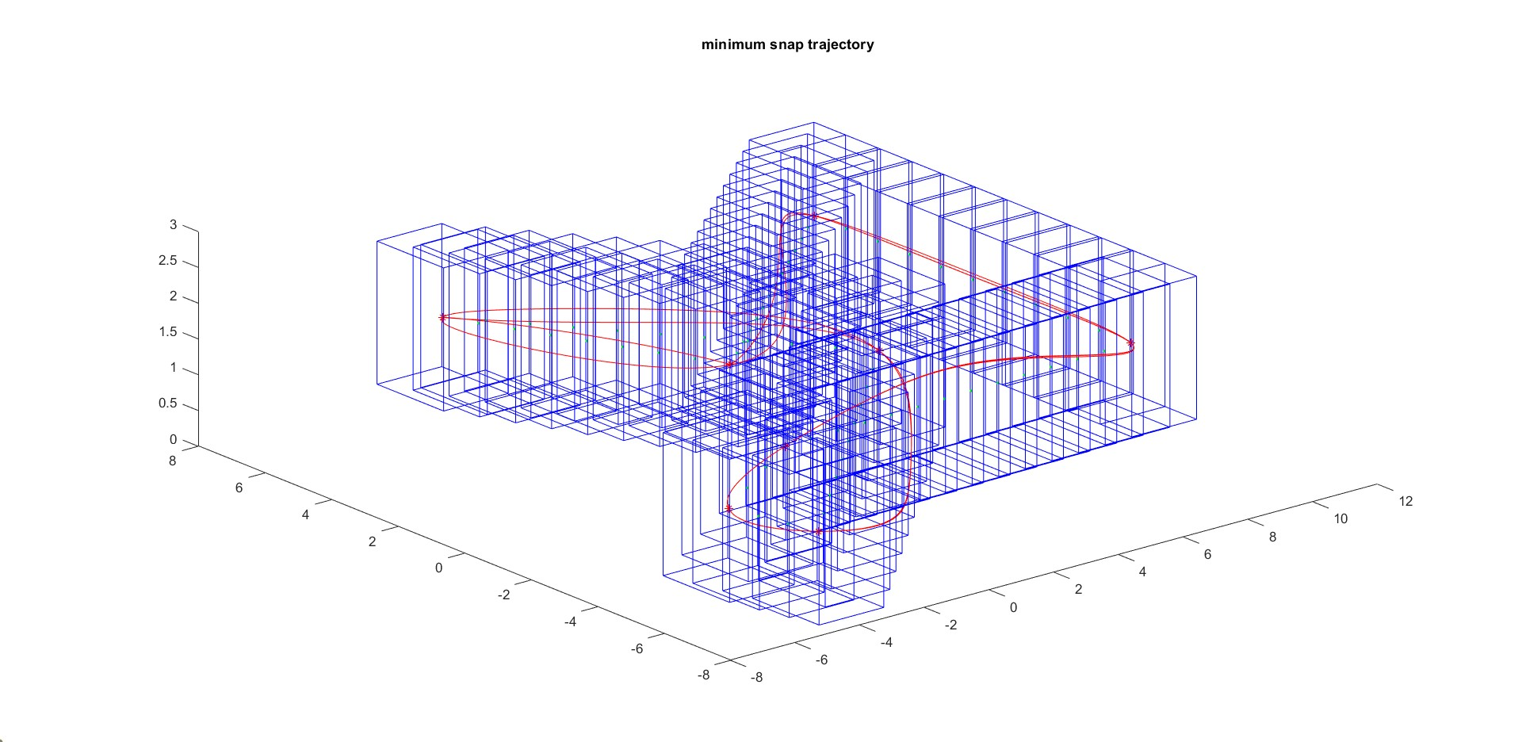
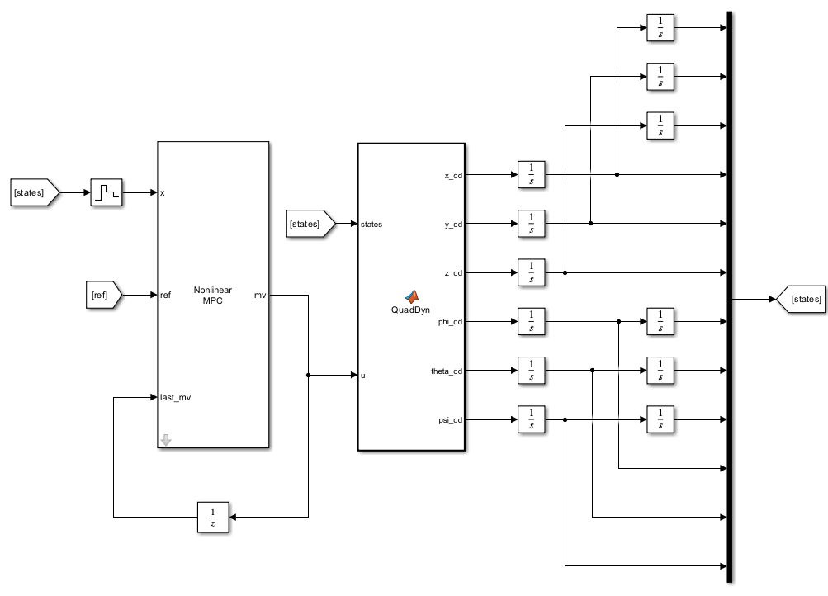
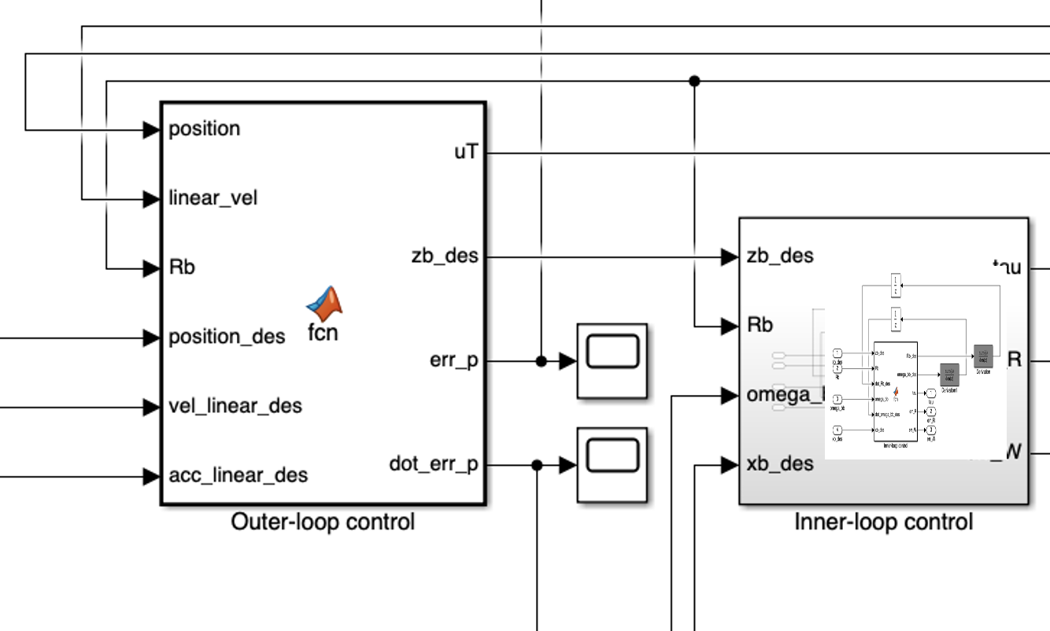
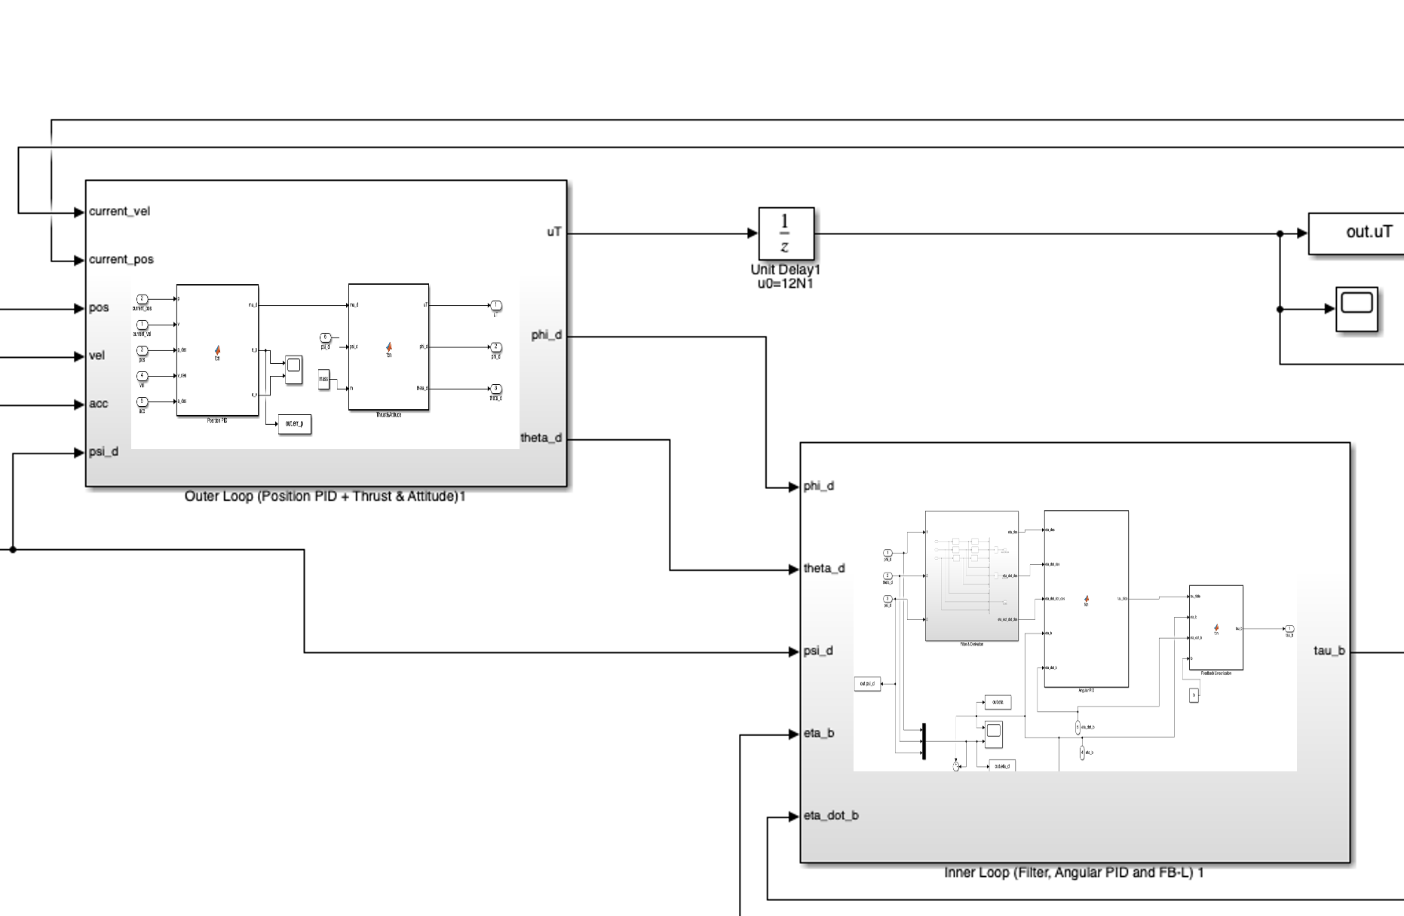
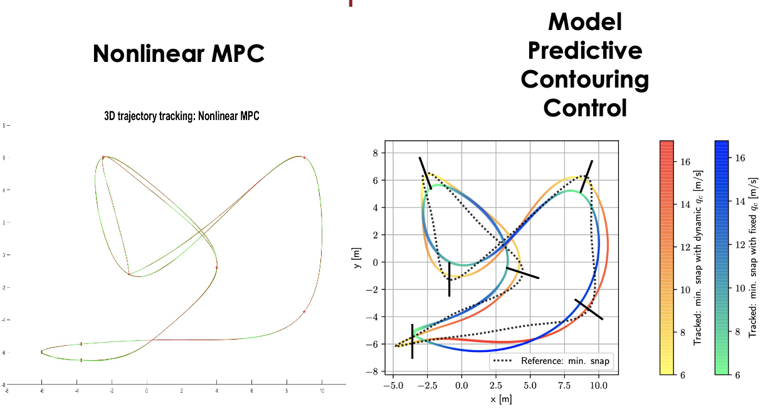
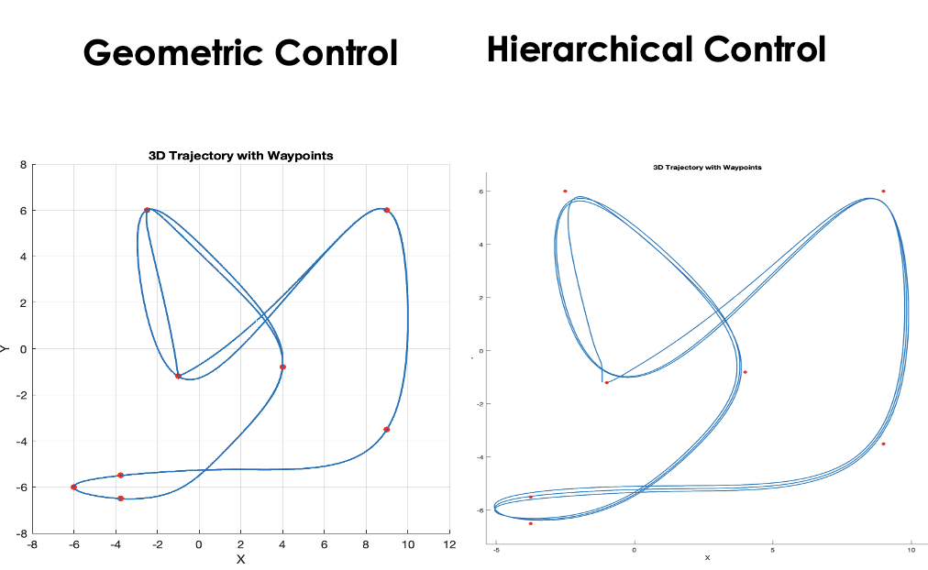
DIPARTIMENTO DI INGEGNERIA ELETTRICA E TECNOLOGIE DELL’INFORMAZIONE
SCUOLA POLITECNICA E DELLE SCIENZE DI BASE
LAUREA MAGISTRALE IN INGEGNERIA DELL’AUTOMAZIONE E ROBOTICA
Field and Service Robotics Minimum Snap Trajectory and Control Strategies for a Racing Drone Flight
Student: Salvatore Granata - P38000219
Immagine #3
Immagine #4

Slide 2

INDEX
Introduction
Trajectory planning
Minimum-Snap Trajectory Planning
Equality Constraints Definition
Inequality Constraints Definition
Results
Nonlinear Model Predictive Control (NMPC)
Dynamic Model of the Quadcopter
Theoretical Background
Implementation
Model Predictive Contouring Control (quick hints)
Geometric Control
Hierarchical Control
Results and Comparisons
Conclusions
2/25

Slide 3
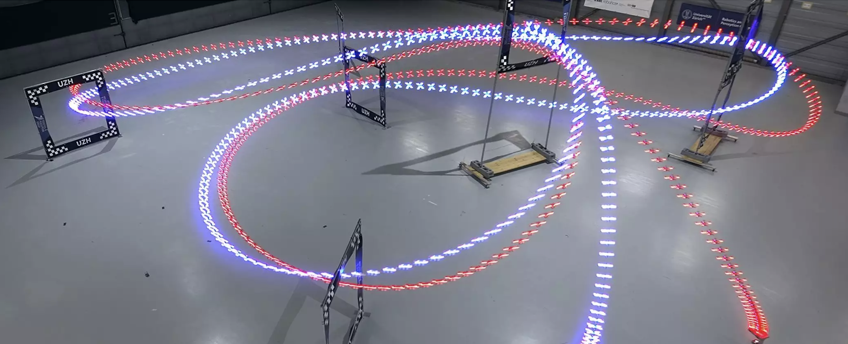
INTRODUCTION
The field of drone racing in recent years is becoming fertile ground for innovation with respect to the development of control systems for autonomous drones given the high performance required for the system to deal with the race and the goal of competing with highly skilled human pilots.
The technical work discusses a method of developing and implementing a tracking system for an autonomous racing drone, starting with the generation of the reference in terms of trajectory via a constrained "minimum-snap" approach and moving on to the implementation of different control strategies for tracking that reference. The results obtained will then be compared each other and with what can be considered the cutting edge in the field, a Model Predictive Contouring Control approach developed for the same purposes by Dr. Davide Scaramuzza of the UZH
3/25

Slide 4
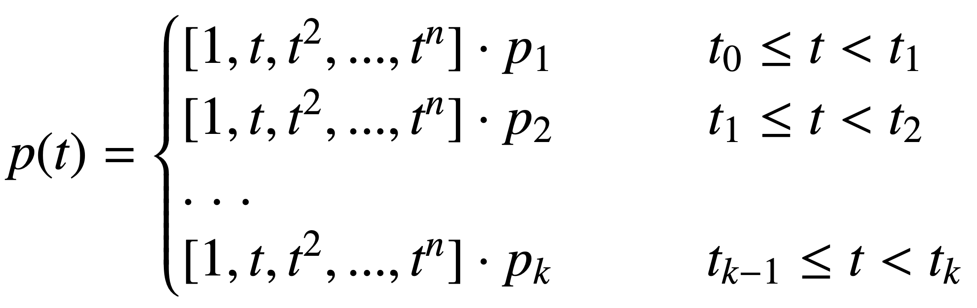
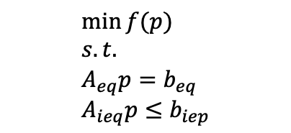
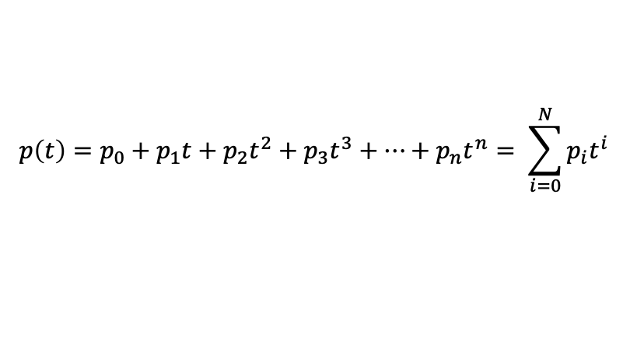
TRAJECTORY PLANNING
Minimum-Snap Trajectory Planning
In order to ensure continuity and differentiability up to the N-2th derivative of position, trajectories are generally represented by Nth-order polynomials, i.e.:
$$p\left(t\right)=p_{0}+p_{1}t+p_{2}t^{2}+p_{3}t^{3}+…+p_{n}t^{n}= \sum_{i=0}^{N}{p_{i}t^{i}}$$
The path has been divided into a sequence of polynomial traits where continuity constraints become fundamental to make it work.
The goal of the trajectory planning is to find the polynomial parameters of the trajectory, imposing a set of constraints. In this way the problem can be modeled as a constrained optimization problem, formulated as:
$$\min{f(p)} \\ s.t. \\ A_{eq}p=b_{eq} \\ A_{ieq}p≤b_{iep}$$
4/25

Slide 5
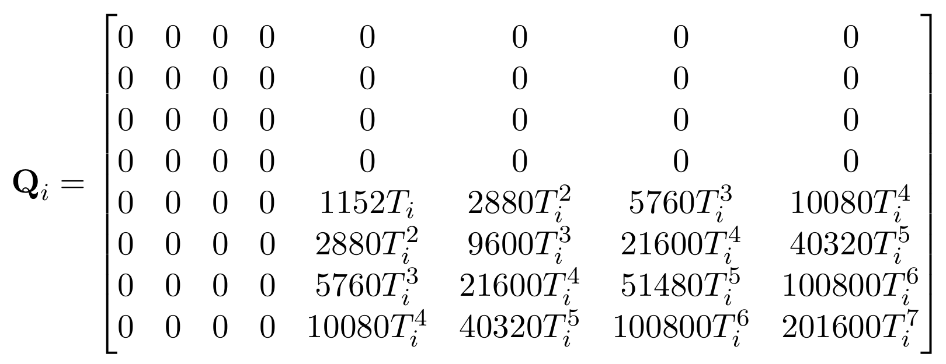
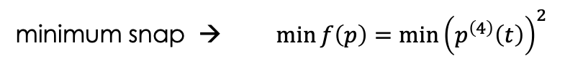
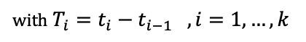
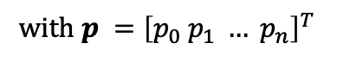
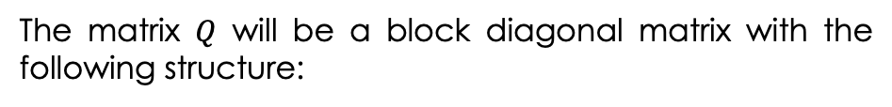
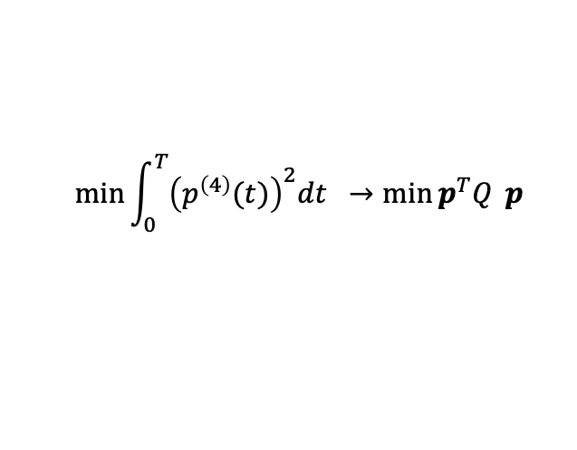
TRAJECTORY PLANNING
Minimum-Snap Trajectory Planning
The aim is to minimize the function $f(p)$ keeping the equality and inequality constraints always satisfied. Since the trajectory planning is said to be "minimum snap", as the name suggest, the objective function to be minimized is the snap:
snap → $p^{\left(4\right)}\left(t\right)=\frac{d^{4}p(t)}{dt^{4}}=\left[0 0 0 0 24 …\frac{n!}{n−4!} t^{n−4}\right]p$
with $p ={\left[p_{0} p_{1} … p_{n}\right]}^{T}$
minimum snap → $\min{f\left(p\right)}={\min\left(p^{\left(4\right)}\left(t\right)\right)}^{2}$
Applying this formula, the aim is to minimize the snap of the trajectory to be travelled in an interval of time $T$
$$\min{\int_{0}^{T}{{\left(p^{\left(4\right)}(t)\right)}^{2}dt } →\min{p^{T}Q} p}$$
which turns out to be the known form of quadratic programming (QP) problems.
The matrix $Q$ will be a block diagonal matrix with the following structure:
with $T_{i}=t_{i}−t_{i−1} , i=1,…,k$
5/25

Slide 6
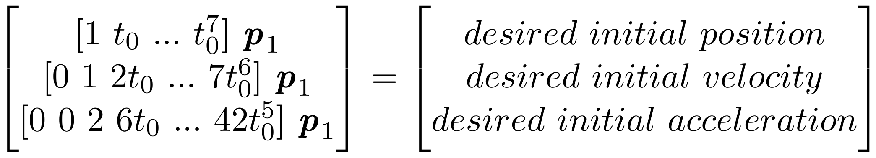
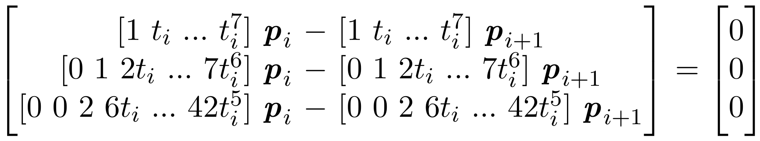
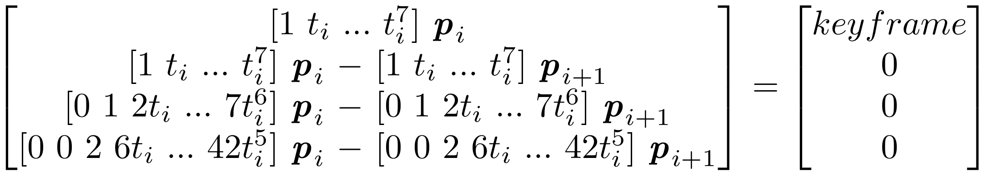
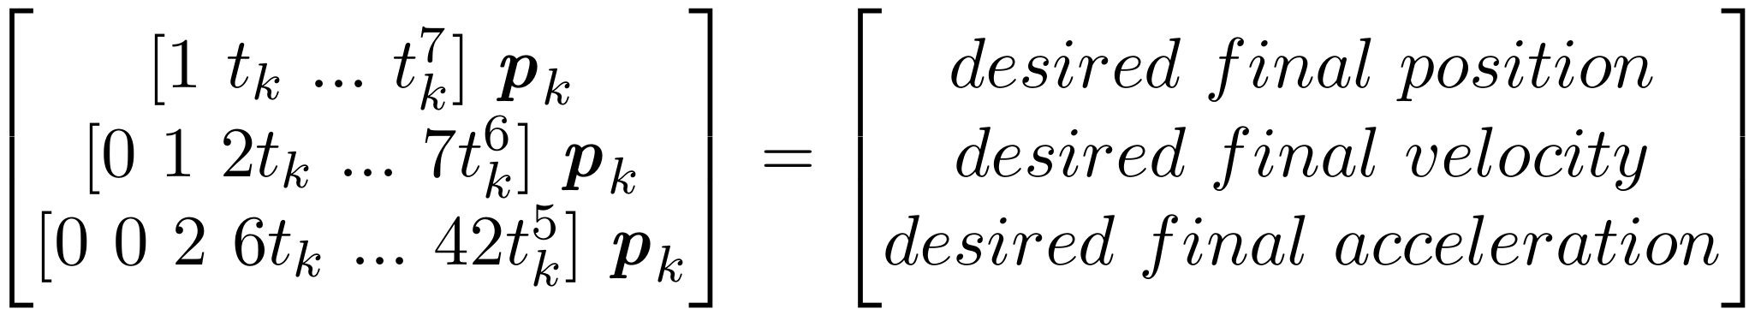
TRAJECTORY PLANNING
Equality Constraints Definition
$$A_{eq}p=b_{eq}$$
Initial Conditions Constraint
Continuity Constraint
Keyframe Constraint
Final Conditions Constraint
6/25

Slide 7
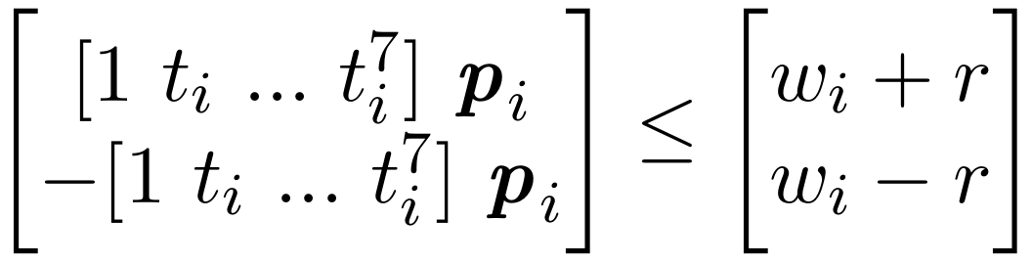
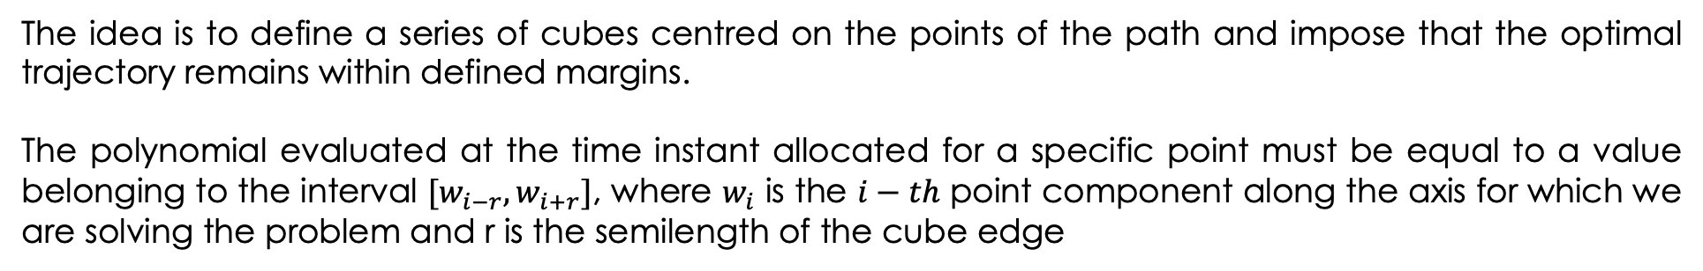
TRAJECTORY PLANNING
Inequality Constraints Definition
$$A_{ieq}p≤b_{iep}$$
The idea is to define a series of cubes centred on the points of the path and impose that the optimal trajectory remains within defined margins.
The polynomial evaluated at the time instant allocated for a specific point must be equal to a value belonging to the interval $[w_{i−r},w_{i+r}]$, where $w_{i}$ is the $i−th$ point component along the axis for which we are solving the problem and r is the semilength of the cube edge
Corridor Constraint
7/25

Slide 8
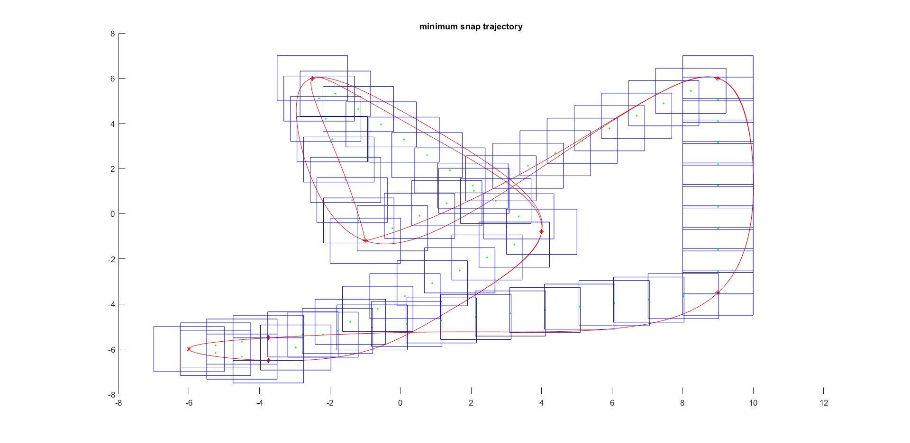
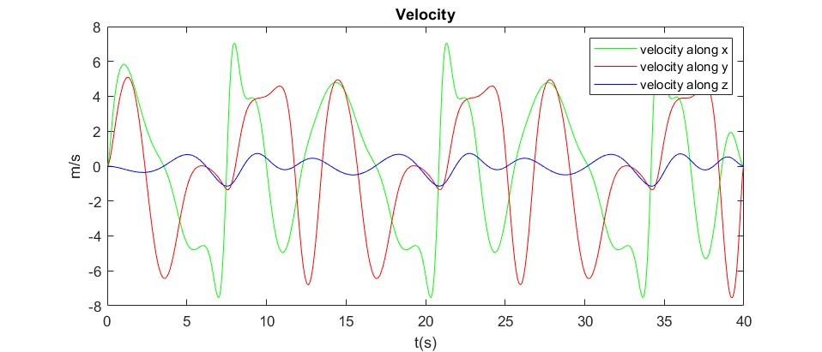
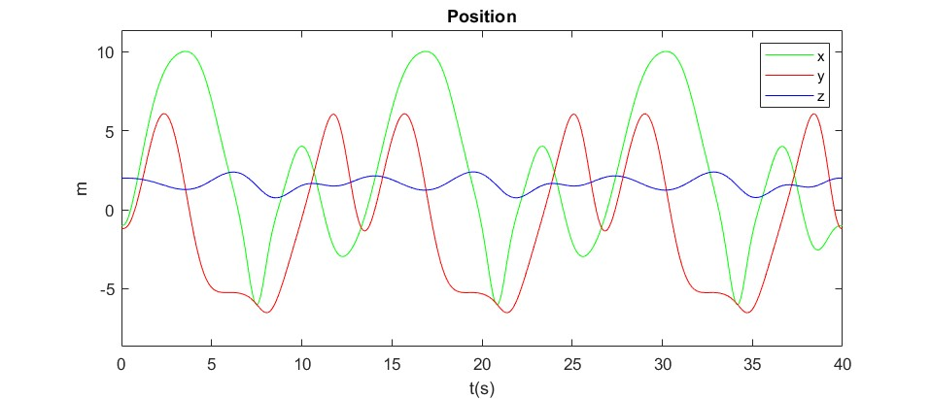
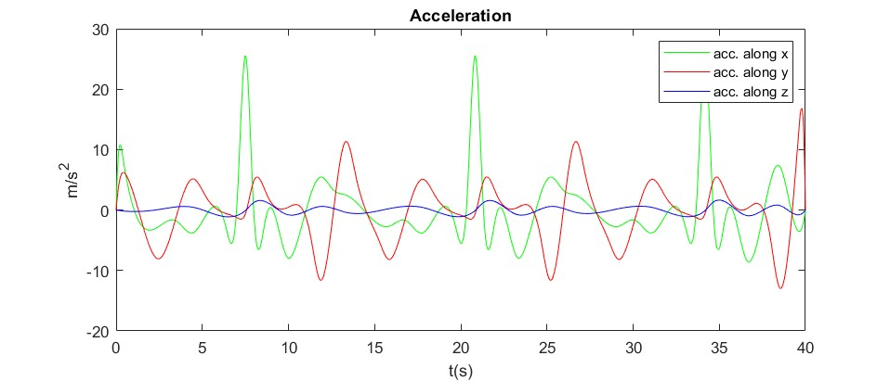
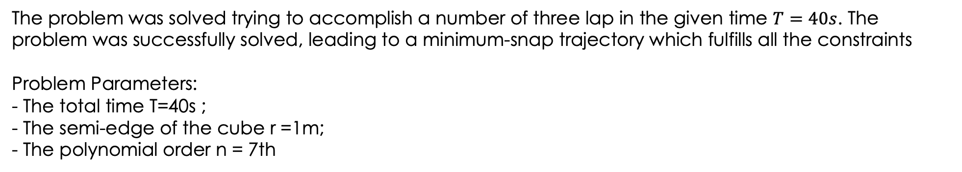
TRAJECTORY PLANNING
Results
The problem was solved trying to accomplish a number of three lap in the given time $T=40s$. The problem was successfully solved, leading to a minimum-snap trajectory which fulfills all the constraints
Problem Parameters:
- The total time T=40s ;
- The semi-edge of the cube r =1m;
- The polynomial order n = 7th
8/25

Slide 9
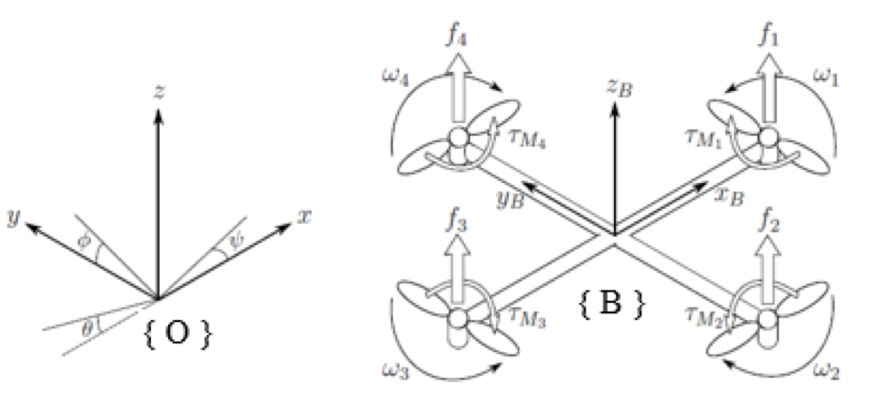
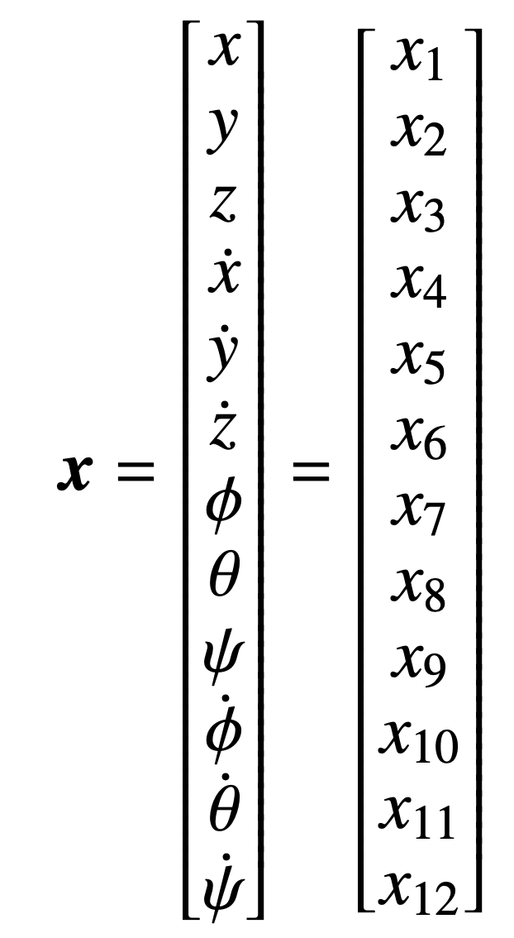
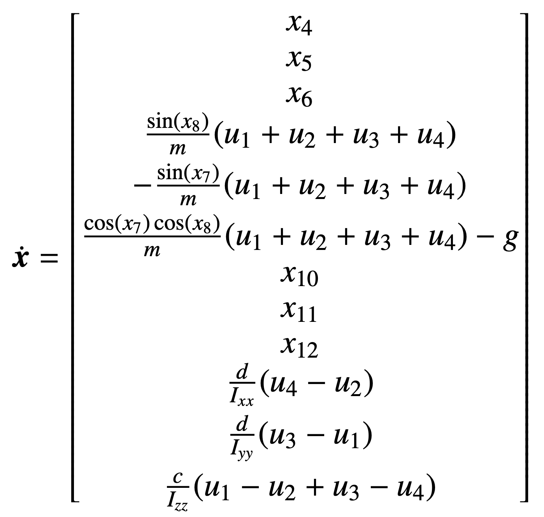
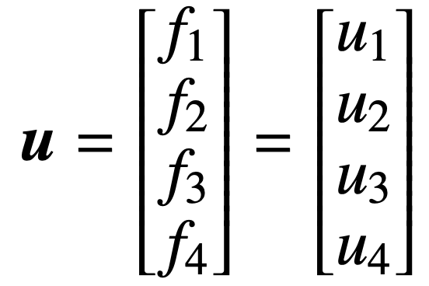
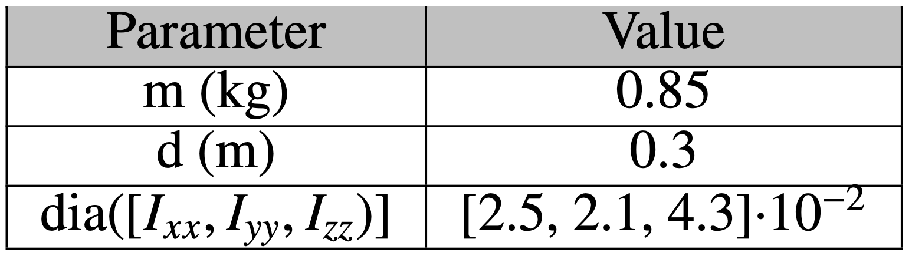
NONLINEAR MODEL PREDICTIVE CONTROL (NMPC)
Dynamic Model of the Quadcopter
→ ODE
9/25

Slide 10
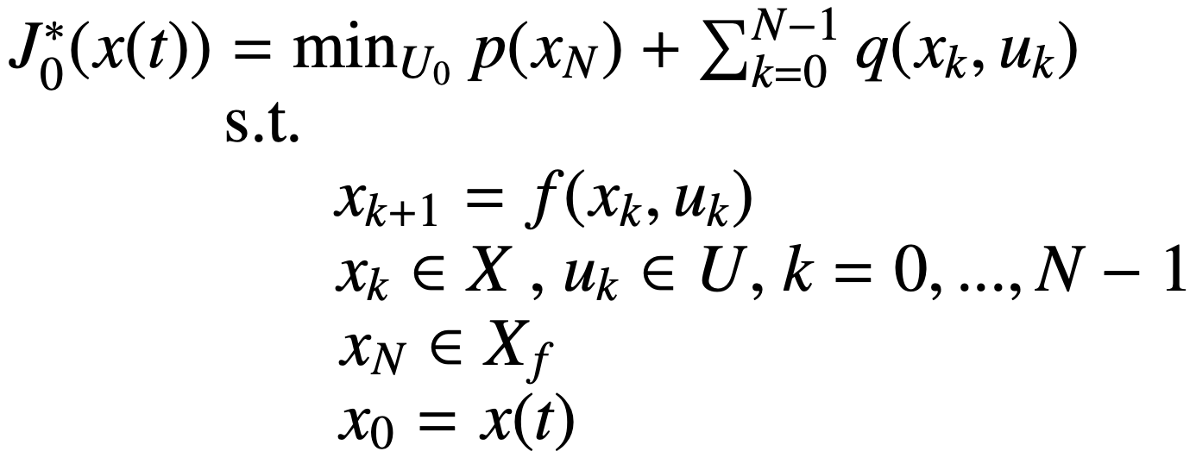
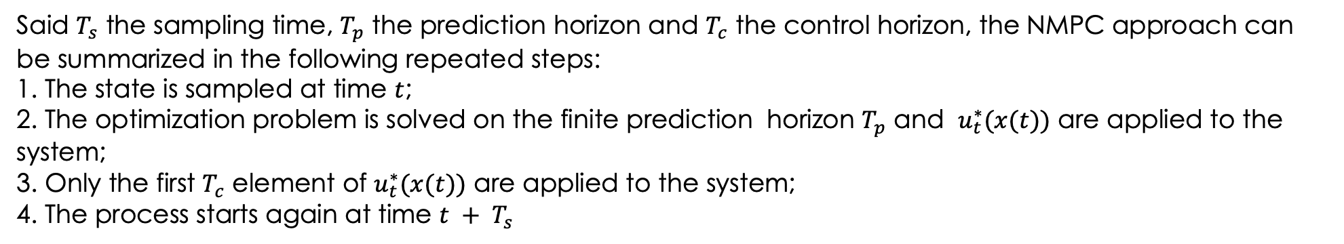
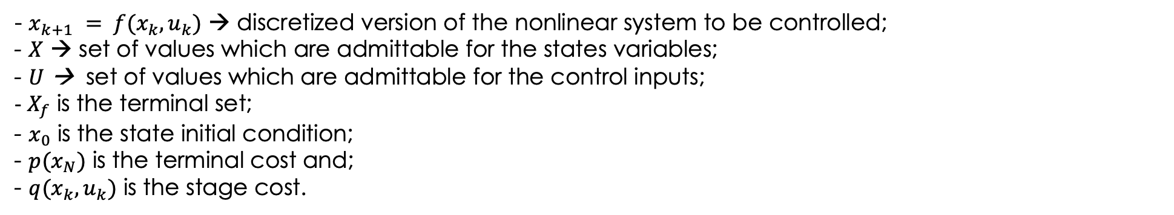
NONLINEAR MODEL PREDICTIVE CONTROL (NMPC)
Theoretical Background
The aim is to solve an optimization problem which formulated as
- $x_{k+1} = f(x_{k},u_{k})$ → discretized version of the nonlinear system to be controlled;
- $X$ → set of values which are admittable for the states variables;
- $U$ → set of values which are admittable for the control inputs;
- $X_{f}$ is the terminal set;
- $x_{0}$ is the state initial condition;
- $p(x_{N})$ is the terminal cost and;
- $q(x_{k},u_{k})$ is the stage cost.
Said $T_{s}$ the sampling time, $T_{p}$ the prediction horizon and $T_{c}$ the control horizon, the NMPC approach can be summarized in the following repeated steps:
1. The state is sampled at time $t$; 2. The optimization problem is solved on the finite prediction horizon $T_{p}$ and $u_{t}^{∗}(x(t))$ are applied to the system; 3. Only the first $T_{c}$ element of $u_{t}^{∗}(x(t))$ are applied to the system;
4. The process starts again at time $t + T_{s}$
10/25

Slide 11

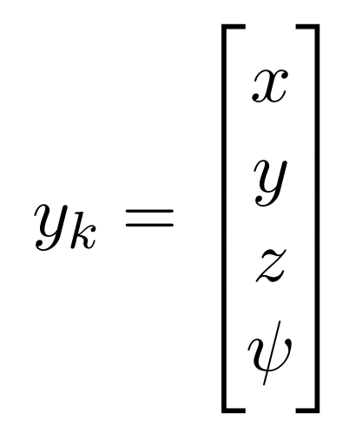
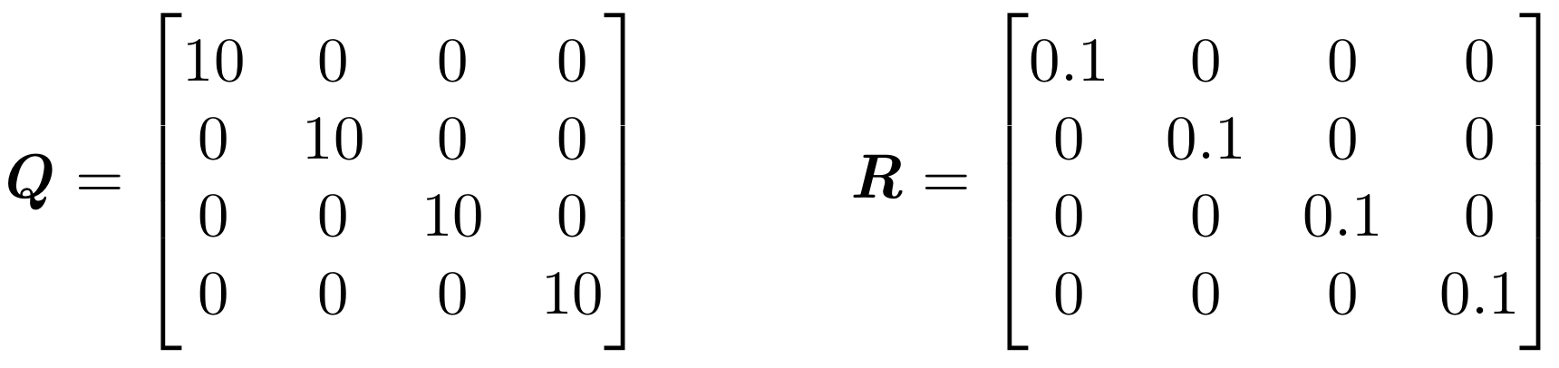
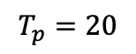
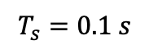
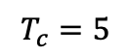
NONLINEAR MODEL PREDICTIVE CONTROL (NMPC)
Implementation
The NMPC has been developed in MATLAB and Simulink exploiting the Model Predictive Control Toolbox which provides functions and Simulink blocks to develop model predictive controller to simplify their adoption in simulations
Cost function:
Output:
Configuration parameters:
$$T_{s}=0.1 s$$
$$T_{p}=20$$
$$T_{c}=5$$
Weight Matrices:
11/25

Slide 12
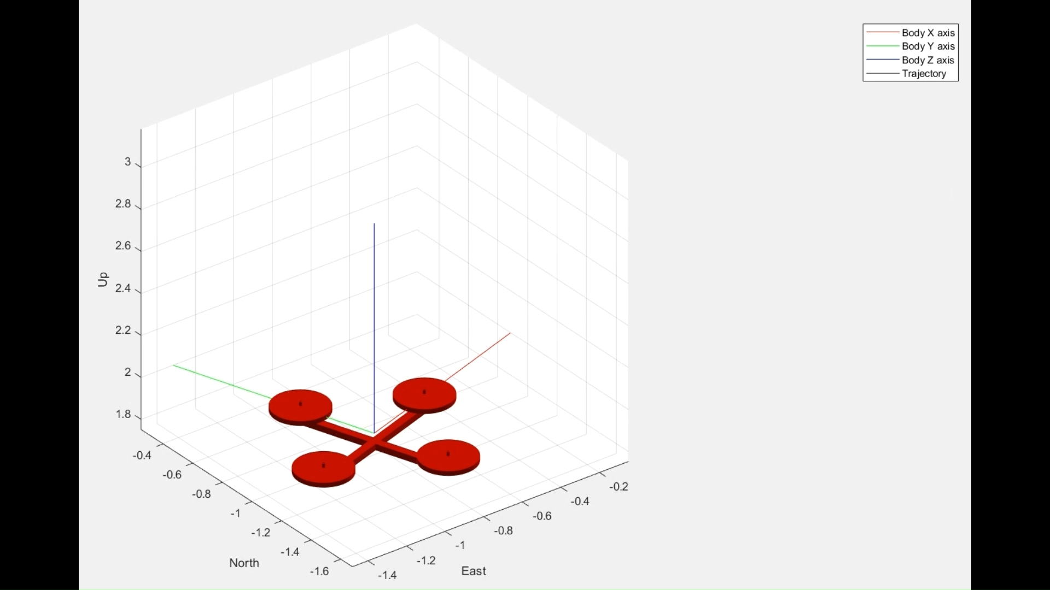
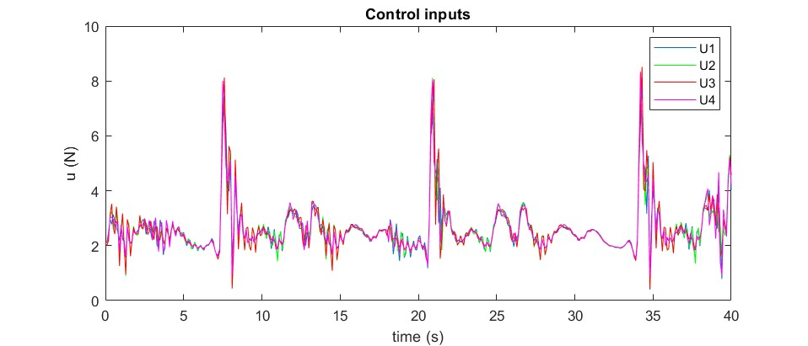
NONLINEAR MODEL PREDICTIVE CONTROL (NMPC)
12/25

Slide 13
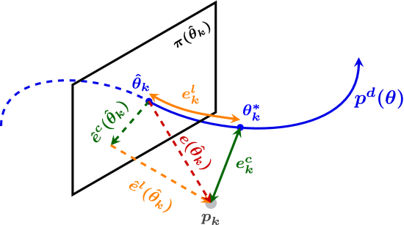
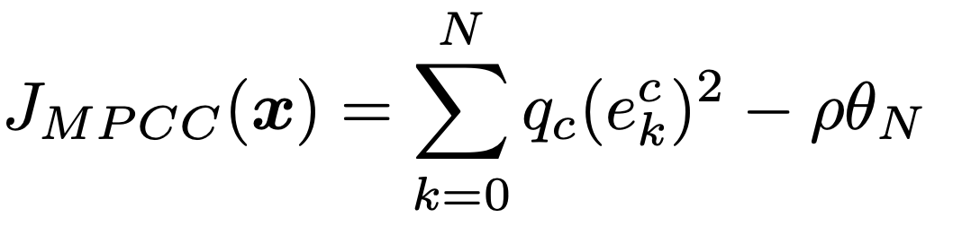
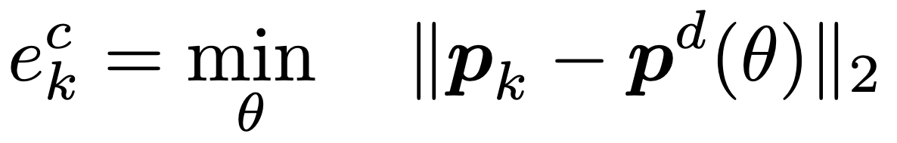
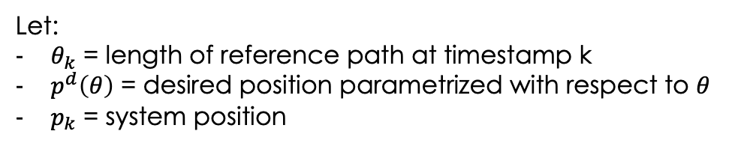
MODEL PREDICTIVE CONTOURING CONTROL (MPCC)
In contrast to standard MPC methods, where a time-sampled state and input reference is tracked, MPCC methods consider the higher-level task of minimizing the Euclidean distance to a three-dimensional path while maximizing the speed at which the path is traversed.
Let:
$θ_{k}$ = length of reference path at timestamp k
$p^{d}\left(θ\right)$ = desired position parametrized with respect to $θ$
$p_{k}$ = system position
The Model Predictive Contouring Control formulation attempts to minimize the projected distance from the current position $p_{k}$ to the desired position $p^{d}\left(θ\right)$while maximizing the progress $θ$ along it.
- $e_{k}^{c}$ is the contouring error defined as:
- $q_{c}$ is the contour weight
13/25

Slide 14
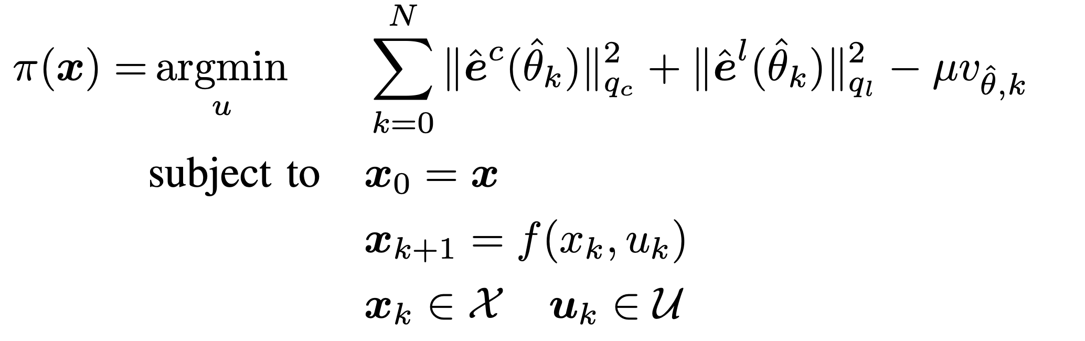
MODEL PREDICTIVE CONTOURING CONTROL (MPCC)
With the necessary simplifications and approximations to adapt this reasoning to an online optimization, the problem can be formulated as:
where:
${\hat{e}}^{l}$ approximates the lag error $|\left|θ_{k}^{∗}−{\hat{θ}}_{k}\right||$, with the corresponding weight $q_{l}$
$v_{{\hat{θ}}_{k},k}$ is a virtual control to be determined at each timestamp, with $μ>0$
14/25

Slide 15
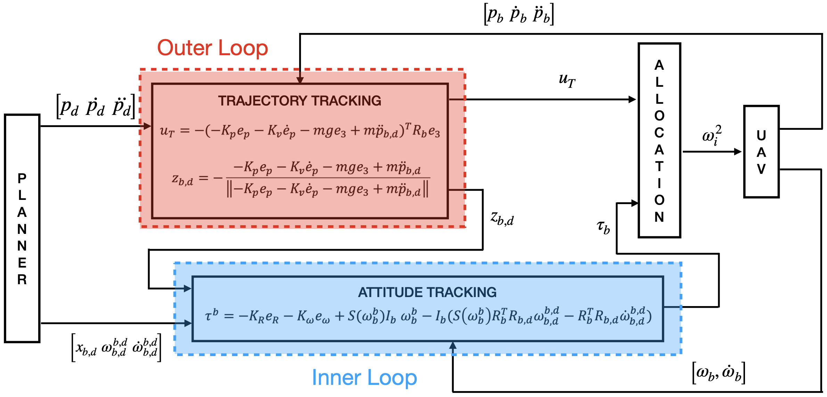
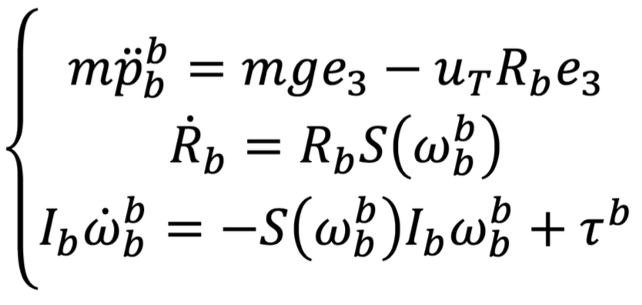
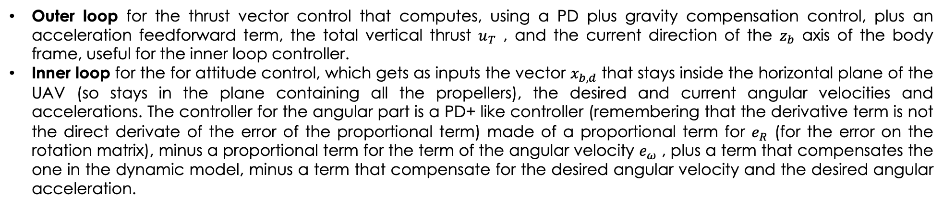
Geometric Control
Geometric Control is based on a coordinate-free dynamic model using rotation matrices in SO(3), constructing a dynamic model of the errors directly in SO(3) (where there are no singularities)
This strategy applies feedback linearization on this error model with a two-loop control structure:
Outer loop for the thrust vector control that computes, using a PD plus gravity compensation control, plus an acceleration feedforward term, the total vertical thrust $u_{T}$ , and the current direction of the $z_{b}$ axis of the body frame, useful for the inner loop controller.
Inner loop for the for attitude control, which gets as inputs the vector $x_{b,d}$ that stays inside the horizontal plane of the UAV (so stays in the plane containing all the propellers), the desired and current angular velocities and accelerations. The controller for the angular part is a PD+ like controller (remembering that the derivative term is not the direct derivate of the error of the proportional term) made of a proportional term for $e_{R}$ (for the error on the rotation matrix), minus a proportional term for the term of the angular velocity $e_{ω}$ , plus a term that compensates the one in the dynamic model, minus a term that compensate for the desired angular velocity and the desired angular acceleration.
15/25

Slide 16




Geometric Control
Implementation
SCHEMA SIMULINK E MATRICE GUADAGNI
16/25

Slide 17



Geometric Control
17/25

Slide 18



Hierarchical Control
Hierarchical Control relies on the RPY (roll, pitch, yaw) dynamic model of the UAV:
This strategy applies feedback linearization on this error model with a two-loop control structure:
Outer loop for position control retrieves the desired values of linear position, velocity and acceleration from the planner and the current linear position and velocity of the system and the desired yaw angle, and computes, using a PD control plus a feedforward action for the desired linear acceleration the total vertical thrust $u_{T}$ to be sent to the drone and the desired values for $φ$ and $θ$ useful for the angular control;
Inner loop for attitude control retrieves the desired values for the angles and computes the desired values for the angular position, velocity and acceleration. Then, through a PD control plus a feedforward action for the desired angular acceleration and a feedback linearization it computes the control torques $τ_{b}$ to be sent to the drone.
18/25

Slide 19





Hierarchical Control
Implementation
19/25

Slide 20



Hierarchical Control
20/25

Slide 21




Results and Comparisons
Model Predictive Contouring Control
Nonlinear MPC
Geometric Control
Hierarchical Control
Similar generated trajectories
The proposed NMPC tries to faithfully follow the reference, the MPCC proposed by Scaramuzza carries out both trajectory planning and tracking at the same time, changing the described path at run-time in order to minimize the lap time and maximize the progression along the path.
With a static contouring weight, the MPCC fails in passing through the keyframes, performing worse than the NMPC.
The dynamic contouring weight ensures the quadcopter to pass through the gates but straying further from the reference also to achieve more and different optimal goals.
The Geometric Control performs very well, exhibiting excellent tracking performance
The Hierarchical Control performs worse than every other controller, showing poor tracking capabilities and requiring a bigger time to simulate
21/25

Slide 22





RESULTS AND COMPARISONS
Nonlinear Model Predictive Control
22/25

Slide 23





RESULTS AND COMPARISONS
Geometric Control
23/25

Slide 24





RESULTS AND COMPARISONS
Hierarchical Control
24/25

Slide 25
CONCLUSIONS
This final project work proposes a method to generate a minimum-snap optimal constrained trajectory and different control formulations in the framework of full quadcopter dynamics.
The proposed work is compared to an advanced and innovative Model Predictive Contouring Control which remains still impressive, highlighting the differences between other simpler control approaches. The results from this work aims to show the ongoing developments in the field of autonomous drone racing and to stimulate the reader inventive by highlighting how such context can be extremely challenging. Even considering the innovative results obtained by other researchers used as comparison in this paper, there are still challenges ahead mainly related to onboard state estimation and perception at high speeds. The proposed controller has proven to be a stable approach to fly very aggressive manoeuvres at very high speeds, even if lower than the ones achieved by Scaramuzza.
THANKS FOR THE ATTENTION
25/25

